Slide 1
Wildfire Prediction Model
Prasunethon 29 – 30 June 2024
SoftwareVikshitBharat@2047 🇮🇳

Slide 2
Introduction
Team Mavericks
Welcomes you to the project presentation for the Prasunethon 2024.
Project Title: Wildfire Prediction Model
Domain: Artificial Intelligence
Topic: AI-Based Disaster Prediction and Response System
Problem Statement:
Develop an efficient system to predict wildfire occurrences in advance using state-of-the-art Machine Learning, Data Science, and Artificial Intelligence techniques. This system will analyze time-series data to forecast wildfire events, enabling proactive disaster management and response.

Slide 3
Team Mavericks
Aditya Pawar
Data Science
Data Analysis
Deployment
Pranav Naik
Machine Learning
Web Development
Cyber Security
Tabish Ali Ansari
Artificial Intelligence
Deep Learning
Big Data
We are classmates from AISSMS Institute of Information Technology, Pune. United by our passion for technology, our interests span AI, Data Science, and Cyber Security, driving us to innovate and solve real-world problems.

Slide 4
01
Introduction
Forests and Wildfires

Slide 5
Forests are vital to the health of our planet, serving as habitats for 80% of the world's terrestrial species and supporting incredible biodiversity. They play a crucial role in regulating the climate by absorbing carbon dioxide, thus mitigating the effects of climate change. Additionally, forests are essential for the water cycle, preventing soil erosion, and maintaining clean water supplies. Economically, forests provide a wealth of resources, supporting millions of livelihoods and contributing significantly to global economies. Beyond their environmental and economic value, forests offer recreational spaces that enhance our mental and physical well-being, highlighting their multifaceted importance to human life.
A Wildfire, forest fire, or a bushfire is an unplanned, uncontrolled and unpredictable fire in an area of combustible vegetation. Wildfires represent a significant natural phenomenon with both ecological and societal implications. They often result in the loss of biodiversity and can lead to long-term ecological impacts. Moreover, wildfires contribute to air pollution by releasing large amounts of smoke and carbon dioxide into the atmosphere, affecting air quality and exacerbating climate change. Economically, wildfires cause substantial damage to properties, infrastructure, and natural resources, leading to extensive financial costs for firefighting efforts and post-fire recovery.

Slide 6
02
Project Overview
Wildfire Prediction Model

Slide 7
The requirement for a Wildfire Prediction Model lies deep in:
Environmental Conservation
Early Detection and Response
Public Safety
National Resource Allocation
Economic Impact
Climate Change Mitigation
Our project aims to develop an advanced predictive model using AI and Data Science techniques to forecast wildfire occurrences with high accuracy and reliability. By analyzing historical time-series data and environmental variables, such as temperature, humidity, and wind patterns, our model predicts when and where wildfires are likely to occur.
This proactive approach enables early detection and timely intervention, enhancing disaster preparedness and response strategies. Our team, comprised of passionate students from AISSMS IOIT, leverages expertise in AI, Data Science, and Cyber Security to address this pressing environmental and societal challenge. Through this project, we strive to contribute to the conservation of natural resources, protection of biodiversity, and enhancement of public safety measures against the increasing threat of wildfires.

Slide 8
The Project has been divided into 3 Phases
Data Analysis
Model Building
Deployment
Data Collection
Preprocessing
Analysis & Visualization
Feature Engineering
Time-Series Forecasting
Model Evaluation
Front-end Development
Pipeline Integration
Maintenance

Slide 9
Project Timeline
Step 1
Step 03
Step 05
Data Collection for Phase 1
Data Preparation for Phase 2
Phase 3
Step 02
Step 04
Phase 1
Phase 2

Slide 10
Morocco Wildfire Predictions: 2010-2022 ML Dataset
Link:
https://www.kaggle.com/datasets/ayoubjadouli/morocco-wildfire-predictions-2010-2022-ml-dataset
File Type: Parquet
Size: 209 MB
Source: Kaggle
The core of this dataset is a single, comprehensive file named Date_final_dataset_balanced_float32.parquet, structured in the Parquet format for efficiency and optimized for machine learning workflows. The dataset is meticulously balanced and contains a total of 934,586 rows and 278 columns, encapsulating a wide array of features that are crucial for accurate wildfire prediction models.

Slide 11
Features
Temporal markers like acq_date, day_of_week, day_of_year, and holiday-related flags (is_holiday, is_weekend).
Spatial features such as latitude, longitude, and sea_distance.
Environmental conditions, including NDVI for vegetation health and SoilMoisture.
Weather data lag features for up to 15 days prior, covering average_temperature, maximum_temperature, minimum_temperature, precipitation, snow_depth, wind_speed, and more, providing a comprehensive view of conditions leading up to an event.
Aggregated weather statistics and historical averages over weekly, monthly, quarterly, and yearly periods to capture long-term trends and seasonal impacts on wildfire occurrences.
The outcome variable is_fire indicates the presence (1) or absence (0) of a wildfire, serving as the target for predictive modeling.

Slide 12
03
Data Preparation
Data Collection, Preprocessing, Analysis & Visualization

Slide 13
Data down-sampling
is the process of reducing the number of rows (or samples) in a dataset. This is typically done by selecting a subset of the data according to some criteria.
This Dataset contains 934586 samples, which are approximately a million samples. Hence, we need to reduce the number of samples to ease the exploratory data analysis and data visualization processes. Moreover, this would further aid us in Resource management by increasing the efficiency of resources
being used.

Slide 14
Feature Engineering
Feature engineering involves transforming raw data into meaningful and informative features that can enhance the predictive power of machine learning algorithms. For our project, this process includes selecting and creating features from historical time-series data and various environmental variables. By carefully engineering these features, we can capture complex patterns and relationships that contribute to wildfire occurrences.
The following operations were performed on our dataset:
Feature Extraction
Dimensionality Reduction
Normalization and Standardization
Principal Component Analysis (PCA)
Cross - Validation

Slide 15
04
Model Building
Feature Engineering, Time-Series Forecasting, Model Evaluation

Slide 16
ML Two Model Theory
For this project, Team Mavericks decided to go wild and perform some unique and unprecedented.
We have decided to use not one, but Two Machine Learning Models for this particular project.
“Necessity is the mother of invention.”
Similarly, while working on this project, we discovered the necessity for Time Series Forecasting and as well as Binary Classification for this particularly advanced dataset.
Since there is no such ML model which is capable of performing both the operations independently, we put some light on the novel idea of using two different models!
The first model would be a Multiple Regression model focusing on time series forecasting, producing future values for the features.
The second model will be a Logistic Regression model which will utilize the predicted values to
classify the target feature as 0 or 1.
Both the models shall work hand in hand through integration and pipelines.

Slide 17

Model 1: Linear Regression
This model shall work on Scikit Learn and Facebook Prophet libraries in python.
The primary job is time series forecasting using scikit learn and predicting future values using Facebook prophet.
The future predicted values then shall be used for binary classification.

Slide 18
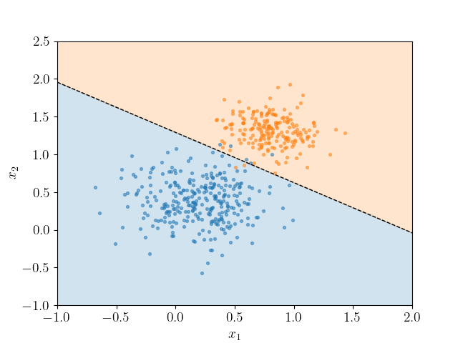
Model 2: Logistic Regression
This model shall work on Scikit Learn and statsmodels in python.
The predicted values will be used to classify the target feature.
The whole point of using two different models integrated through pipelines is to increase accuracy.

Slide 19
05
Deployment
Front-End Development, Validation and Maintenance

Slide 20
The final step in our wildfire prediction model project is deployment, where we transition from development to real-world application. We have created and hosted a user-friendly website that allows stakeholders, including disaster management authorities and the public, to access our wildfire predictions easily. This platform integrates our predictive model and presents the data through intuitive visualizations and interactive maps, enabling users to monitor potential wildfire risks in real-time. By making our model accessible online, we aim to facilitate timely decision-making, enhance community preparedness, and ultimately contribute to more effective wildfire prevention and response strategies.

Slide 21
Advantages of Wildfire Prediction Model
1. Early Warning System
2. Resource Allocation
3. Cost Savings
4. Public Safety
5. Environmental Protection
6. Data-Driven Decisions
7. Insurance Industry Benefits
8. Urban Planning
9. Climate Change Adaptation
10. Research and Development
11. Educational Tool
12. Policy Making
13. Economic Impact Mitigation
14. Community Engagement
15. Adaptability
16. Scalability
17. Customizability
18. Integration with Existing Systems
19. Public Awareness
20. Supporting Sustainable Practices

Slide 22

Thank You
for being with us till the end!
This project was referred from various sourced on the internet, mainly:
Google
ChatGPT (Debugging)
GitHub (Referencing)
Kaggle
GitHub repo link for our project:
https://github.com/tabishaliansari/Prasunethon-Mavericks
Please do visit!

